Slide 1
Lecture 10:
Mapreduce

Slide 2
Overview of Today’s Lecture
Map/reduce
Pig-Latin
Some slides from Alan Gates (Yahoo!Research)
Mini-tutorial on the slides

Slide 3
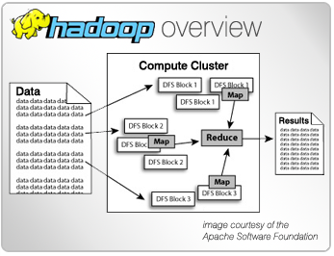
What is Hadoop?
Open-source data storage and processing API
Massively scalable, automatically parallelizable
Based on work from Google
GFS + MapReduce + BigTable
Current Distributions based on Open Source and Vendor Work
Apache Hadoop
Cloudera – CH4 w/ Impala
Hortonworks
MapR
AWS
Windows Azure HDInsight
Notes:
http://en.wikipedia.org/wiki/MapReduce

Slide 4
Hadoop is a set of Apache Frameworks and more…
Data storage (HDFS)
Runs on commodity hardware (usually Linux)
Horizontally scalable
Processing (MapReduce)
Parallelized (scalable) processing
Fault Tolerant
Other Tools / Frameworks
Data Access
HBase, Hive, Pig, Mahout
Tools
Hue, Sqoop
Monitoring
Greenplum, Cloudera
Monitoring & Alerting
Tools & Libraries
Data Access
MapReduce API
Hadoop Core - HDFS
Notes:
http://www.platfora.com/wp-content/themes/PlatforaV2.0/img/enter/deployment_pick_graphic.png

Slide 5
What are the core parts of a Hadoop distribution?
HDFS Storage
Redundant (3 copies)
For large files – large blocks
64 or 128 MB / block
Can scale to 1000s of nodes
MapReduce API
Batch (Job) processing
Distributed and Localized to clusters (Map)
Auto-Parallelizable for huge amounts of data
Fault-tolerant (auto retries)
Adds high availability and more
Other Libraries
Pig
Hive
HBase
Others

Slide 6
Hadoop Cluster HDFS (Physical) Storage
Name Node
Data Node 1
Data Node 2
Data Node 3
Secondary Name Node
One Name Node
Contains web site to view cluster information
V2 Hadoop uses multiple Name Nodes for HA
Many Data Nodes
3 copies of each node by default
Work with data in HDFS
Using common Linux shell commands
Block size is 64 or 128 MB

Slide 7
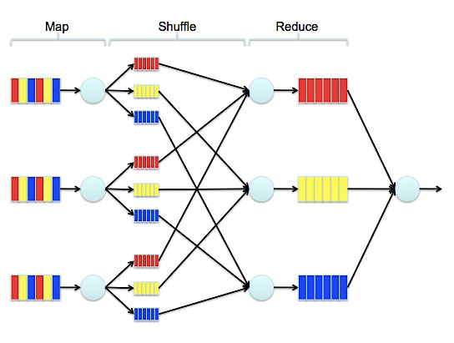
MapReduce Job – Logical View
Image from - http://mm-tom.s3.amazonaws.com/blog/MapReduce.png

Slide 8
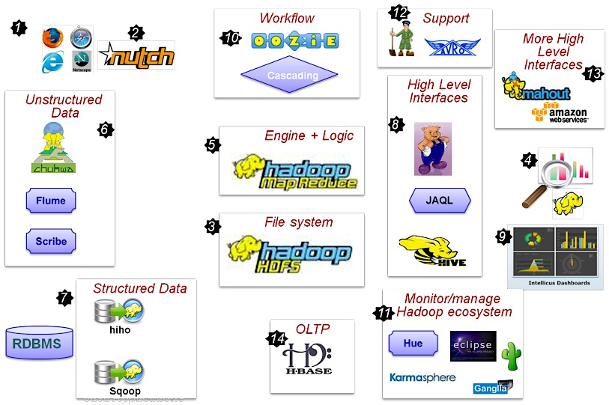
Hadoop Ecosystem
Notes:
http://indoos.files.wordpress.com/2010/08/hadoop_map1.png?w=819&h=612

Slide 9
Ways to MapReduce
Libraries
Languages
HBase
Hive
Pig
Sqoop
Oozie
Mahout
Others…
Java*
HiveQL (HQL)
Pig Latin
Python
C#
JavaScript
R
More…
Note: Java is most common, but other languages can be used
Notes:
http://www.dataspora.com/2011/04/pigs-bees-and-elephants-a-comparison-of-eight-mapreduce-languages/

Slide 10

Setting up Hadoop Development
Hadoop Binaries
Cloudera’s Demo VM
Need Virtualization software, i.e. VMware, etc…
Data Storage
Local
HDFS Pseudo-distributed (single-node)
MapReduce
Local
Cloud
Local install
Linux
Windows
File System
Cloud
AWS
Azure
Others
Cloud
AWS
Microsoft (Beta)
Others
Other Libraries & Tools
Vendor Tools
Libraries
Notes:
Image from: http://vichargrave.com/wp-content/uploads/2013/02/Hadoop-Development.png
http://wiki.apache.org/hadoop/HowToSetupYourDevelopmentEnvironment
https://ccp.cloudera.com/display/SUPPORT/Cloudera's+Hadoop+Demo+VM+for+CDH4

Slide 11
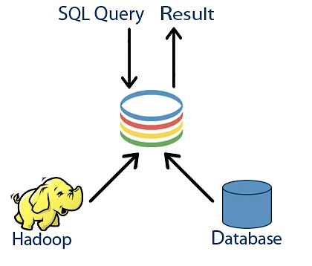
So, what’s the problem?
“I can just use some ‘SQL-like’ language to query Hadoop, right?
“Yeah, SQL-on-Hadoop…that’s what I want
“I don’t want learn a new query language and….
“I want massive scale for my shiny, new BigData
Notes:
http://queryio.com/hadoop-big-data-images/hadoop-sql.jpg

Slide 12

What is Hive?
a data warehouse system for Hadoop that
facilitates easy data summarization
supports ad-hoc queries (still batch though…)
created by Facebook
a mechanism to project structure onto this data and query the data using a SQL-like language – HiveQL
Interactive-console –or-
Execute scripts
Kicks off one or more MapReduce jobs in the background
an ability to use indexes, built-in user-defined functions
Notes:
http://hive.apache.org/
https://cwiki.apache.org/confluence/display/Hive/GettingStarted

Slide 13
Is HQL == ANSI SQL? – NO!
--non-equality joins ARE allowed on ANSI SQL
--but are NOT allowed on Hive (HQL)
SELECT a.*
FROM a
JOIN b ON (a.id <> b.id)
Note: Joins are quite different in MapReduce, more on that coming up…
Notes:
https://cwiki.apache.org/confluence/display/Hive/LanguageManual
http://en.wikipedia.org/wiki/Apache_Hive

Slide 14
Map Reduce
Google: paper published 2004
Free variant: Hadoop
Map-reduce = high-level programming model and implementation for large-scale parallel data processing

Slide 15
Data Model
Files !
A file = a bag of (key, value) pairs
A map-reduce program:
Input: a bag of (inputkey, value)pairs
Output: a bag of (outputkey, value)pairs

Slide 16
Step 1: the MAP Phase
User provides the MAP-function:
Input: one (input key, value)
Ouput: bag of (intermediate key, value)pairs
System applies the map function in parallel to all (input key, value) pairs in the input file

Slide 17
Step 2: the REDUCE Phase
User provides the REDUCE function:
Input: (intermediate key, bag of values)
Output: bag of output values
System groups all pairs with the same intermediate key, and passes the bag of values to the REDUCE function

Slide 18
Example
Counting the number of occurrences of each word in a large collection of documents
map(String key, String value): // key: document name // value: document contents for each word w in value: EmitIntermediate(w, “1”):
reduce(String key, Iterator values): // key: a word // values: a list of counts int result = 0; for each v in values: result += ParseInt(v); Emit(AsString(result));

Slide 19
MAP
REDUCE
(k1,v1)
(k2,v2)
(k3,v3)
. . . .
(i1, w1)
(i2, w2)
(i3, w3)
. . . .

Slide 20
Map = GROUP BY, Reduce = Aggregate
R(documentKey, word)
SELECT word, sum(1)
FROM R
GROUP BY word

Slide 21
Understanding MapReduce – P1/3
Map>>
(K1, V1) →
Info in
Input Split
list (K2, V2)
Key / Value out (intermediate values)
One list per local node
Can implement local Reducer (or Combiner)
Notes:
The Hadoop MapReduce framework spawns one map task for each InputSplit generated by the InputFormat for the job.

Slide 22
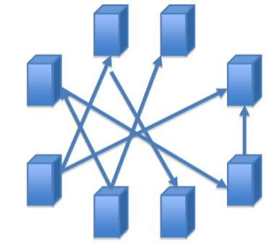
Understanding MapReduce – P2/3
Map>>
(K1, V1) →
Info in
Input Split
list (K2, V2)
Key / Value out (intermediate values)
One list per local node
Can implement local Reducer (or Combiner)
Shuffle/Sort>>
Notes:
The Hadoop MapReduce framework spawns one map task for each InputSplit generated by the InputFormat for the job.

Slide 23
Understanding MapReduce – P3/3
Map>>
(K1, V1) →
Info in
Input Split
list (K2, V2)
Key / Value out (intermediate values)
One list per local node
Can implement local Reducer (or Combiner)
Shuffle/Sort>>
Reduce
(K2, list(V2) →
Shuffle / Sort phase precedes Reduce phase
Combines Map output into a list
list (K3, V3)
Usually aggregates intermediate values
(input) <k1, v1> → map → <k2, v2> → combine → <k2, v2> → reduce → <k3, v3> (output)
Notes:
The Hadoop MapReduce framework spawns one map task for each InputSplit generated by the InputFormat for the job.

Slide 24
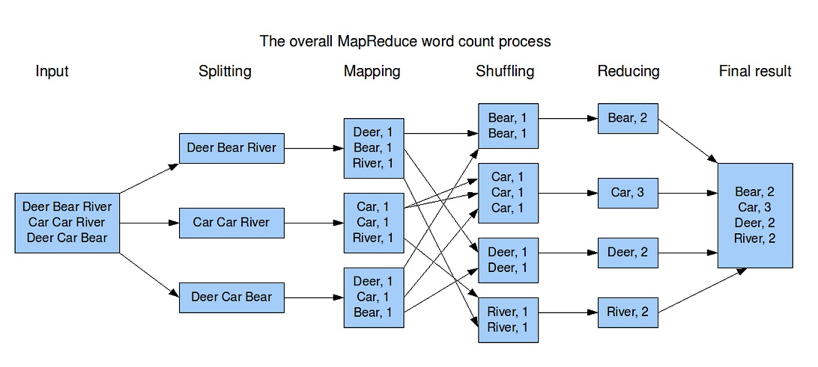
MapReduce Example - WordCount
Image from: http://blog.jteam.nl/wp-content/uploads/2009/08/MapReduceWordCountOverview1.png

Slide 25
Implementation
There is one master node
Master partitions input file into M splits, by key
Master assigns workers (=servers) to the M map tasks, keeps track of their progress
Workers write their output to local disk, partition into R regions
Master assigns workers to the R reduce tasks
Reduce workers read regions from the map workers’ local disks

Slide 26
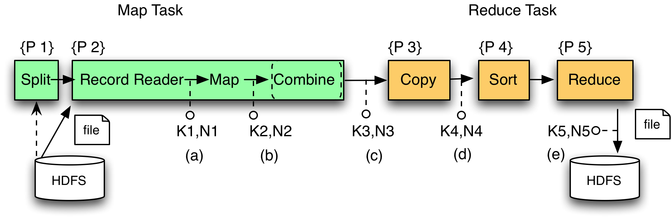
MR Phases
`
Local storage

Slide 27
Interesting Implementation Details
Worker failure:
Master pings workers periodically,
If down then reassigns its splits to all other workers → good load balance
Choice of M and R:
Larger is better for load balancing
Limitation: master needs O(M×R) memory

Slide 28
Interesting Implementation Details
Backup tasks:
Straggler = a machine that takes unusually long time to complete one of the last tasks. Eg:
Bad disk forces frequent correctable errors (30MB/s → 1MB/s)
The cluster scheduler has scheduled other tasks on that machine
Stragglers are a main reason for slowdown
Solution: pre-emptive backup execution of the last few remaining in-progress tasks

Slide 29
Map-Reduce Summary
Hides scheduling and parallelization details
However, very limited queries
Difficult to write more complex tasks
Need multiple map-reduce operations
Solution:
PIG-Latin !

Slide 30
Following Slides provided by: Alan Gates, Yahoo!Research

Slide 31

What is Pig?
An engine for executing programs on top of Hadoop
It provides a language, Pig Latin, to specify these programs
An Apache open source project http://hadoop.apache.org/pig/

Slide 32
Map-Reduce
Computation is moved to the data
A simple yet powerful programming model
Map: every record handled individually
Shuffle: records collected by key
Reduce: key and iterator of all associated values
User provides:
input and output (usually files)
map Java function
key to aggregate on
reduce Java function
Opportunities for more control: partitioning, sorting, partial aggregations, etc.

Slide 33
Map Reduce Illustrated
map
map
reduce
reduce

Slide 34
Map Reduce Illustrated
Romeo, Romeo, wherefore art thou Romeo?
What, art thou hurt?
map
map
reduce
reduce

Slide 35
Map Reduce Illustrated
Romeo, Romeo, wherefore art thou Romeo?
What, art thou hurt?
Romeo, 1
Romeo, 1
wherefore, 1
art, 1
thou, 1
Romeo, 1
map
map
What, 1
art, 1
thou, 1
hurt, 1
reduce
reduce

Slide 36
Map Reduce Illustrated
Romeo, Romeo, wherefore art thou Romeo?
What, art thou hurt?
Romeo, 1
Romeo, 1
wherefore, 1
art, 1
thou, 1
Romeo, 1
map
map
What, 1
art, 1
thou, 1
hurt, 1
art, (1, 1)
hurt (1),
thou (1, 1)
reduce
reduce
Romeo, (1, 1, 1)
wherefore, (1)
what, (1)

Slide 37
Map Reduce Illustrated
Romeo, Romeo, wherefore art thou Romeo?
What, art thou hurt?
Romeo, 1
Romeo, 1
wherefore, 1
art, 1
thou, 1
Romeo, 1
map
map
What, 1
art, 1
thou, 1
hurt, 1
art, (1, 1)
hurt (1),
thou (1, 1)
reduce
reduce
Romeo, (1, 1, 1)
wherefore, (1)
what, (1)
art, 2
hurt, 1
thou, 2
Romeo, 3
wherefore, 1
what, 1

Slide 38
Making Parallelism Simple
Sequential reads = good read speeds
In large cluster failures are guaranteed; Map Reduce handles retries
Good fit for batch processing applications that need to touch all your data:
data mining
model tuning
Bad fit for applications that need to find one particular record
Bad fit for applications that need to communicate between processes; oriented around independent units of work

Slide 39
Why use Pig?
Suppose you have user data in one file, website data in another, and you need to find the top 5 most visited sites by users aged 18 - 25.
Load Users
Load Pages
Filter by age
Join on name
Group on url
Count clicks
Order by clicks
Take top 5

Slide 40
In Map-Reduce
170 lines of code, 4 hours to write

Slide 41
In Pig Latin
Users = load ‘users’ as (name, age); Fltrd = filter Users by age >= 18 and age <= 25; Pages = load ‘pages’ as (user, url); Jnd = join Fltrd by name, Pages by user; Grpd = group Jnd by url; Smmd = foreach Grpd generate group, COUNT(Jnd) as clicks; Srtd = order Smmd by clicks desc; Top5 = limit Srtd 5; store Top5 into ‘top5sites’;
9 lines of code, 15 minutes to write

Slide 42
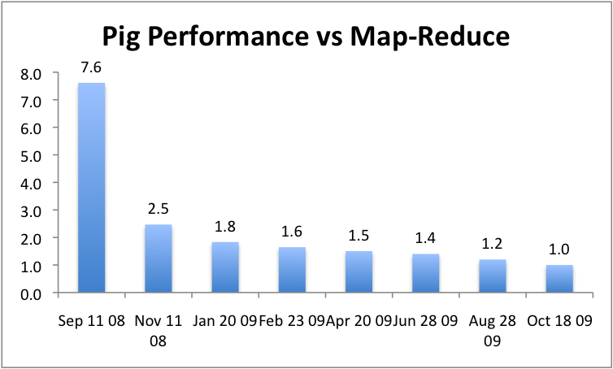
But can it fly?

Slide 43
Essence of Pig
Map-Reduce is too low a level to program, SQL too high
Pig Latin, a language intended to sit between the two:
Imperative
Provides standard relational transforms (join, sort, etc.)
Schemas are optional, used when available, can be defined at runtime
User Defined Functions are first class citizens
Opportunities for advanced optimizer but optimizations by programmer also possible

Slide 44


How It Works
Plan standard optimizations
Logical Plan ≈ relational algebra
Script
A = load
B = filter
C = group
D = foreach
Logical Plan
Logical Plan
Parser
Semantic
Checks
Logical
Optimizer
Logical Plan
MapReduce
Launcher
Physical
To MR
Translator
Logical to
Physical
Translator
Map-Reduce Plan
Physical Plan
Jar to
hadoop
Map-Reduce Plan = physical operators broken into Map, Combine, and Reduce stages
Physical Plan = physical operators to be executed

Slide 45
Cool Things We’ve Added In the Last Year
Multiquery – Ability to combine multiple group bys into a single MR job (0.3)
Merge join – If data is already sorted on join key, do join via merge in map phase (0.4)
Skew join – Hash join for data with skew in join key. Allows splitting of key across multiple reducers to handle skew. (0.4)
Zebra – Contrib project that provides columnar storage of data (0.4)
Rework of Load and Store functions to make them much easier to write (0.7, branched but not released)
Owl, a metadata service for the grid (committed, will be released in 0.8).

Slide 46
Fragment Replicate Join
Aka “Broakdcast Join”
Pages
Users
Notes:
Running example: You start a webiste. You want to know how users are using your website. So you collect a couple of streams of information from your logs: page views and users.
When you start you have a fair number of page views, but not many users.
In this algorithm the smaller table is copied to every map in its entirety (doesn’t yet use Distributed Cache, it should). Larger file is partitioned as per normal MR.

Slide 47
Fragment Replicate Join
Aka “Broakdcast Join”
Users = load ‘users’ as (name, age); Pages = load ‘pages’ as (user, url); Jnd = join Pages by user, Users by name using “replicated”;
Pages
Users
Notes:
Running example: You start a webiste. You want to know how users are using your website. So you collect a couple of streams of information from your logs: page views and users.
When you start you have a fair number of page views, but not many users.
In this algorithm the smaller table is copied to every map in its entirety (doesn’t yet use Distributed Cache, it should). Larger file is partitioned as per normal MR.

Slide 48
Fragment Replicate Join
Aka “Broakdcast Join”
Users = load ‘users’ as (name, age); Pages = load ‘pages’ as (user, url); Jnd = join Pages by user, Users by name using “replicated”;
Pages
Users
Notes:
Running example: You start a webiste. You want to know how users are using your website. So you collect a couple of streams of information from your logs: page views and users.
When you start you have a fair number of page views, but not many users.
In this algorithm the smaller table is copied to every map in its entirety (doesn’t yet use Distributed Cache, it should). Larger file is partitioned as per normal MR.

Slide 49
Fragment Replicate Join
Aka “Broakdcast Join”
Users = load ‘users’ as (name, age); Pages = load ‘pages’ as (user, url); Jnd = join Pages by user, Users by name using “replicated”;
Map 1
Pages
Users
Map 2
Notes:
Running example: You start a webiste. You want to know how users are using your website. So you collect a couple of streams of information from your logs: page views and users.
When you start you have a fair number of page views, but not many users.
In this algorithm the smaller table is copied to every map in its entirety (doesn’t yet use Distributed Cache, it should). Larger file is partitioned as per normal MR.

Slide 50
Fragment Replicate Join
Aka “Broakdcast Join”
Users = load ‘users’ as (name, age); Pages = load ‘pages’ as (user, url); Jnd = join Pages by user, Users by name using “replicated”;
Map 1
Pages
block 1
Users
Pages
Users
Map 2
Pages
block 2
Users
Notes:
Running example: You start a webiste. You want to know how users are using your website. So you collect a couple of streams of information from your logs: page views and users.
When you start you have a fair number of page views, but not many users.
In this algorithm the smaller table is copied to every map in its entirety (doesn’t yet use Distributed Cache, it should). Larger file is partitioned as per normal MR.

Slide 51
Hash Join
Pages
Users
Notes:
As your website grows, the number of unique users grows beyond what you can keep in memory.
A given map only gets input from a given input source. It can therefore annotate tuples from that source with information on which source it came from. The join key is then used to partition the data, but the join key plus the input source id is used to sort it. This allows pig to buffer one side of the join keys in memory and then use that as a probe table as keys from the other input stream by.

Slide 52
Hash Join
Users = load ‘users’ as (name, age); Pages = load ‘pages’ as (user, url); Jnd = join Users by name, Pages by user;
Pages
Users
Notes:
As your website grows, the number of unique users grows beyond what you can keep in memory.
A given map only gets input from a given input source. It can therefore annotate tuples from that source with information on which source it came from. The join key is then used to partition the data, but the join key plus the input source id is used to sort it. This allows pig to buffer one side of the join keys in memory and then use that as a probe table as keys from the other input stream by.

Slide 53
Hash Join
Users = load ‘users’ as (name, age); Pages = load ‘pages’ as (user, url); Jnd = join Users by name, Pages by user;
Pages
Users
Notes:
As your website grows, the number of unique users grows beyond what you can keep in memory.
A given map only gets input from a given input source. It can therefore annotate tuples from that source with information on which source it came from. The join key is then used to partition the data, but the join key plus the input source id is used to sort it. This allows pig to buffer one side of the join keys in memory and then use that as a probe table as keys from the other input stream by.

Slide 54
Hash Join
Users = load ‘users’ as (name, age); Pages = load ‘pages’ as (user, url); Jnd = join Users by name, Pages by user;
Map 1
User
block n
Pages
Users
Map 2
Page
block m
Notes:
As your website grows, the number of unique users grows beyond what you can keep in memory.
A given map only gets input from a given input source. It can therefore annotate tuples from that source with information on which source it came from. The join key is then used to partition the data, but the join key plus the input source id is used to sort it. This allows pig to buffer one side of the join keys in memory and then use that as a probe table as keys from the other input stream by.

Slide 55
Hash Join
Users = load ‘users’ as (name, age); Pages = load ‘pages’ as (user, url); Jnd = join Users by name, Pages by user;
Map 1
(1, user)
User
block n
Pages
Users
Map 2
Page
block m
(2, name)
Notes:
As your website grows, the number of unique users grows beyond what you can keep in memory.
A given map only gets input from a given input source. It can therefore annotate tuples from that source with information on which source it came from. The join key is then used to partition the data, but the join key plus the input source id is used to sort it. This allows pig to buffer one side of the join keys in memory and then use that as a probe table as keys from the other input stream by.

Slide 56
Hash Join
Users = load ‘users’ as (name, age); Pages = load ‘pages’ as (user, url); Jnd = join Users by name, Pages by user;
Map 1
Reducer 1
(1, user)
User
block n
(1, fred)
(2, fred)
(2, fred)
Pages
Users
Map 2
Reducer 2
Page
block m
(1, jane)
(2, jane)
(2, jane)
(2, name)
Notes:
As your website grows, the number of unique users grows beyond what you can keep in memory.
A given map only gets input from a given input source. It can therefore annotate tuples from that source with information on which source it came from. The join key is then used to partition the data, but the join key plus the input source id is used to sort it. This allows pig to buffer one side of the join keys in memory and then use that as a probe table as keys from the other input stream by.

Slide 57
Skew Join
Pages
Users
Notes:
As your website grows even more, some pages become significantly more popular than others. This means that some pages are visited by almost every user, while others are visited only by a few users.
First, a sampling pass is done to determine which keys are large enough to need special attention. These are keys that have enough values that we estimate we cannot hold the entire value in memory. It’s about holding the values in memory, not the key.
Then at partitioning time, those keys are handled specially. All other keys are treated as in the regular join. These selected keys from input1 are split across multiple reducers. For input2, they are replicated to each of these reducers that had the split. In this way we guarantee that every instance of key k from input1 comes into contact with every instance of k from input2.

Slide 58
Skew Join
Users = load ‘users’ as (name, age); Pages = load ‘pages’ as (user, url); Jnd = join Pages by user, Users by name using “skewed”;
Pages
Users
Notes:
As your website grows even more, some pages become significantly more popular than others. This means that some pages are visited by almost every user, while others are visited only by a few users.
First, a sampling pass is done to determine which keys are large enough to need special attention. These are keys that have enough values that we estimate we cannot hold the entire value in memory. It’s about holding the values in memory, not the key.
Then at partitioning time, those keys are handled specially. All other keys are treated as in the regular join. These selected keys from input1 are split across multiple reducers. For input2, they are replicated to each of these reducers that had the split. In this way we guarantee that every instance of key k from input1 comes into contact with every instance of k from input2.

Slide 59
Skew Join
Users = load ‘users’ as (name, age); Pages = load ‘pages’ as (user, url); Jnd = join Pages by user, Users by name using “skewed”;
Pages
Users
Notes:
As your website grows even more, some pages become significantly more popular than others. This means that some pages are visited by almost every user, while others are visited only by a few users.
First, a sampling pass is done to determine which keys are large enough to need special attention. These are keys that have enough values that we estimate we cannot hold the entire value in memory. It’s about holding the values in memory, not the key.
Then at partitioning time, those keys are handled specially. All other keys are treated as in the regular join. These selected keys from input1 are split across multiple reducers. For input2, they are replicated to each of these reducers that had the split. In this way we guarantee that every instance of key k from input1 comes into contact with every instance of k from input2.

Slide 60
Skew Join
Users = load ‘users’ as (name, age); Pages = load ‘pages’ as (user, url); Jnd = join Pages by user, Users by name using “skewed”;
Map 1
Pages
block n
Pages
Users
Map 2
Users
block m
Notes:
As your website grows even more, some pages become significantly more popular than others. This means that some pages are visited by almost every user, while others are visited only by a few users.
First, a sampling pass is done to determine which keys are large enough to need special attention. These are keys that have enough values that we estimate we cannot hold the entire value in memory. It’s about holding the values in memory, not the key.
Then at partitioning time, those keys are handled specially. All other keys are treated as in the regular join. These selected keys from input1 are split across multiple reducers. For input2, they are replicated to each of these reducers that had the split. In this way we guarantee that every instance of key k from input1 comes into contact with every instance of k from input2.

Slide 61
Skew Join
Users = load ‘users’ as (name, age); Pages = load ‘pages’ as (user, url); Jnd = join Pages by user, Users by name using “skewed”;
Map 1
SP
Pages
block n
Pages
Users
Map 2
SP
Users
block m
Notes:
As your website grows even more, some pages become significantly more popular than others. This means that some pages are visited by almost every user, while others are visited only by a few users.
First, a sampling pass is done to determine which keys are large enough to need special attention. These are keys that have enough values that we estimate we cannot hold the entire value in memory. It’s about holding the values in memory, not the key.
Then at partitioning time, those keys are handled specially. All other keys are treated as in the regular join. These selected keys from input1 are split across multiple reducers. For input2, they are replicated to each of these reducers that had the split. In this way we guarantee that every instance of key k from input1 comes into contact with every instance of k from input2.

Slide 62
Skew Join
Users = load ‘users’ as (name, age); Pages = load ‘pages’ as (user, url); Jnd = join Pages by user, Users by name using “skewed”;
Map 1
SP
(1, user)
Pages
block n
Pages
Users
Map 2
SP
Users
block m
(2, name)
Notes:
As your website grows even more, some pages become significantly more popular than others. This means that some pages are visited by almost every user, while others are visited only by a few users.
First, a sampling pass is done to determine which keys are large enough to need special attention. These are keys that have enough values that we estimate we cannot hold the entire value in memory. It’s about holding the values in memory, not the key.
Then at partitioning time, those keys are handled specially. All other keys are treated as in the regular join. These selected keys from input1 are split across multiple reducers. For input2, they are replicated to each of these reducers that had the split. In this way we guarantee that every instance of key k from input1 comes into contact with every instance of k from input2.

Slide 63
Skew Join
Users = load ‘users’ as (name, age); Pages = load ‘pages’ as (user, url); Jnd = join Pages by user, Users by name using “skewed”;
Map 1
SP
Reducer 1
(1, user)
Pages
block n
(1, fred, p1)
(1, fred, p2)
(2, fred)
Pages
Users
Map 2
SP
Reducer 2
Users
block m
(1, fred, p3)
(1, fred, p4)
(2, fred)
(2, name)
Notes:
As your website grows even more, some pages become significantly more popular than others. This means that some pages are visited by almost every user, while others are visited only by a few users.
First, a sampling pass is done to determine which keys are large enough to need special attention. These are keys that have enough values that we estimate we cannot hold the entire value in memory. It’s about holding the values in memory, not the key.
Then at partitioning time, those keys are handled specially. All other keys are treated as in the regular join. These selected keys from input1 are split across multiple reducers. For input2, they are replicated to each of these reducers that had the split. In this way we guarantee that every instance of key k from input1 comes into contact with every instance of k from input2.

Slide 64
Merge Join
Pages
Users
aaron
.
.
.
.
.
.
.
.
zach
aaron
.
.
.
.
.
.
.
.
zach
Notes:
Now lets say that for some reason you start keeping both your page view data and user data sorted by user.
Note that one way to do this is make sure that pages and users are partitioned the same way. But this leads to a big problem. In order to make sure you can join all your data sets you end up using the same hash function to join them all. But rarely does one bucketing scheme make sense for all your data. Whatever is big enough for one data set will be too small for others, and vice versa. So Pig’s implementation doesn’t depend on how the data is split.
Pig does this by sampling one of the inputs and then building an index from that sample that indicates the key for the first record in every split. The other input is used as the standard input file for Hadoop and is split to the maps as per normal. When the map begins processing this file, when it encounters the first key in that file it uses the index to determine where it should open the second, sampled file. It then opens the file at the appropriate point, seeks forward until it finds the key it is looking for, and then begins doing a join on the two data sources.

Slide 65
Merge Join
Users = load ‘users’ as (name, age); Pages = load ‘pages’ as (user, url); Jnd = join Pages by user, Users by name using “merge”;
Pages
Users
aaron
.
.
.
.
.
.
.
.
zach
aaron
.
.
.
.
.
.
.
.
zach
Notes:
Now lets say that for some reason you start keeping both your page view data and user data sorted by user.
Note that one way to do this is make sure that pages and users are partitioned the same way. But this leads to a big problem. In order to make sure you can join all your data sets you end up using the same hash function to join them all. But rarely does one bucketing scheme make sense for all your data. Whatever is big enough for one data set will be too small for others, and vice versa. So Pig’s implementation doesn’t depend on how the data is split.
Pig does this by sampling one of the inputs and then building an index from that sample that indicates the key for the first record in every split. The other input is used as the standard input file for Hadoop and is split to the maps as per normal. When the map begins processing this file, when it encounters the first key in that file it uses the index to determine where it should open the second, sampled file. It then opens the file at the appropriate point, seeks forward until it finds the key it is looking for, and then begins doing a join on the two data sources.

Slide 66
Merge Join
Users = load ‘users’ as (name, age); Pages = load ‘pages’ as (user, url); Jnd = join Pages by user, Users by name using “merge”;
Pages
Users
aaron
.
.
.
.
.
.
.
.
zach
aaron
.
.
.
.
.
.
.
.
zach
Notes:
Now lets say that for some reason you start keeping both your page view data and user data sorted by user.
Note that one way to do this is make sure that pages and users are partitioned the same way. But this leads to a big problem. In order to make sure you can join all your data sets you end up using the same hash function to join them all. But rarely does one bucketing scheme make sense for all your data. Whatever is big enough for one data set will be too small for others, and vice versa. So Pig’s implementation doesn’t depend on how the data is split.
Pig does this by sampling one of the inputs and then building an index from that sample that indicates the key for the first record in every split. The other input is used as the standard input file for Hadoop and is split to the maps as per normal. When the map begins processing this file, when it encounters the first key in that file it uses the index to determine where it should open the second, sampled file. It then opens the file at the appropriate point, seeks forward until it finds the key it is looking for, and then begins doing a join on the two data sources.

Slide 67
Merge Join
Users = load ‘users’ as (name, age); Pages = load ‘pages’ as (user, url); Jnd = join Pages by user, Users by name using “merge”;
Map 1
Pages
Users
Pages
Users
aaron
.
.
.
.
.
.
.
.
zach
aaron
.
.
.
.
.
.
.
.
zach
aaron…
amr
aaron
…
Map 2
Pages
Users
amy…
barb
amy
…
Notes:
Now lets say that for some reason you start keeping both your page view data and user data sorted by user.
Note that one way to do this is make sure that pages and users are partitioned the same way. But this leads to a big problem. In order to make sure you can join all your data sets you end up using the same hash function to join them all. But rarely does one bucketing scheme make sense for all your data. Whatever is big enough for one data set will be too small for others, and vice versa. So Pig’s implementation doesn’t depend on how the data is split.
Pig does this by sampling one of the inputs and then building an index from that sample that indicates the key for the first record in every split. The other input is used as the standard input file for Hadoop and is split to the maps as per normal. When the map begins processing this file, when it encounters the first key in that file it uses the index to determine where it should open the second, sampled file. It then opens the file at the appropriate point, seeks forward until it finds the key it is looking for, and then begins doing a join on the two data sources.

Slide 68
Multi-store script
A = load ‘users’ as (name, age, gender, city, state);
B = filter A by name is not null;
C1 = group B by age, gender;
D1 = foreach C1 generate group, COUNT(B);
store D into ‘bydemo’;
C2= group B by state;
D2 = foreach C2 generate group, COUNT(B);
store D2 into ‘bystate’;
group by age, gender
apply UDFs
store into ‘bydemo’
load users
filter nulls
group by state
apply UDFs
store into ‘bystate’
Notes:
A very common use case we see at Yahoo is users want to read one data set and group it several different ways. Since scan time often dominates for these large data sets, sharing one scan across several group instances can result in nearly linear speed up of queries.

Slide 69
Multi-Store Map-Reduce Plan
map
filter
split
local rearrange
local rearrange
reduce
demux
package
package
foreach
foreach
Notes:
In this case multiple pipelines are needed in Map and Reduce phases
Due to our pull based model in execution, we have split and multiplex embed the pipelines within themselves
Records are tagged with the pipeline number in the map stage
Grouping is done by Hadoop using a union of the keys
Multiplex operator on the reducer places incoming records in the correct pipeline

Slide 70
What are people doing with Pig
At Yahoo ~70% of Hadoop jobs are Pig jobs
Being used at Twitter, LinkedIn, and other companies
Available as part of Amazon EMR web service and Cloudera Hadoop distribution
What users use Pig for:
Search infrastructure
Ad relevance
Model training
User intent analysis
Web log processing
Image processing
Incremental processing of large data sets

Slide 71
What We’re Working on this Year
Optimizer rewrite
Integrating Pig with metadata
Usability – our current error messages might as well be written in actual Latin
Automated usage info collection
UDFs in python

Slide 72
Research Opportunities
Cost based optimization – how does current RDBMS technology carry over to MR world?
Memory Usage – given that data processing is very memory intensive and Java offers poor control of memory usage, how can Pig be written to use memory well?
Automated Hadoop Tuning – Can Pig figure out how to configure Hadoop to best run a particular script?
Indices, materialized views, etc. – How do these traditional RDBMS tools fit into the MR world?
Human time queries – Analysts want access to the petabytes of data available via Hadoop, but they don’t want to wait hours for their jobs to finish; can Pig find a way to answer analysts question in under 60 seconds?
Map-Reduce-Reduce – Can MR be made more efficient for multiple MR jobs?
How should Pig integrate with workflow systems?
See more: http://wiki.apache.org/pig/PigJournal

Slide 73
Learn More
Visit our website: http://hadoop.apache.org/pig/
On line tutorials
From Yahoo, http://developer.yahoo.com/hadoop/tutorial/
From Cloudera, http://www.cloudera.com/hadoop-training
A couple of Hadoop books are available that include chapters on Pig, search at your favorite bookstore
Join the mailing lists:
pig-user@hadoop.apache.org for user questions
pig-dev@hadoop.apache.com for developer issues
Contribute your work, over 50 people have so far

Slide 74
Pig Latin Mini-Tutorial

Slide 75
Outline
Based entirely on Pig Latin: A not-so-foreign language for data processing, by Olston, Reed, Srivastava, Kumar, and Tomkins, 2008

Slide 76
Pig-Latin Overview
Data model = loosely typed nested relations
Query model = a sql-like, dataflow language
Execution model:
Option 1: run locally on your machine
Option 2: compile into sequence of map/reduce, run on a cluster supporting Hadoop
Main idea: use Opt1 to debug, Opt2 to execute

Slide 77
Example
Input: a table of urls: (url, category, pagerank)
Compute the average pagerank of all sufficiently high pageranks, for each category
Return the answers only for categories with sufficiently many such pages

Slide 78
First in SQL…
SELECT category, AVG(pagerank)
FROM urls
WHERE pagerank > 0.2
GROUP By category
HAVING COUNT(*) > 10⁶

Slide 79
…then in Pig-Latin
good_urls = FILTER urls BY pagerank > 0.2
groups = GROUP good_urls BY category
big_groups = FILTER groups
BY COUNT(good_urls) > 10⁶
output = FOREACH big_groups GENERATE
category, AVG(good_urls.pagerank)

Slide 80
Types in Pig-Latin
Atomic: string or number, e.g. ‘Alice’ or 55
Tuple: (‘Alice’, 55, ‘salesperson’)
Bag: {(‘Alice’, 55, ‘salesperson’), (‘Betty’,44, ‘manager’), …}
Maps: we will try not to use these

Slide 81
Types in Pig-Latin
Bags can be nested !
{(‘a’, {1,4,3}), (‘c’,{ }), (‘d’, {2,2,5,3,2})}
Tuple components can be referenced by number
$0, $1, $2, …

Slide 82
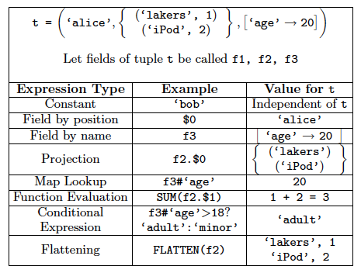

Slide 83
Loading data
Input data = FILES !
Heard that before ?
The LOAD command parses an input file into a bag of records
Both parser (=“deserializer”) and output type are provided by user

Slide 84
Loading data
queries = LOAD ‘query_log.txt’
USING myLoad( )
AS (userID, queryString, timeStamp)

Slide 85
Loading data
USING userfuction( ) -- is optional
Default deserializer expects tab-delimited file
AS type – is optional
Default is a record with unnamed fields; refer to them as $0, $1, …
The return value of LOAD is just a handle to a bag
The actual reading is done in pull mode, or parallelized

Slide 86
FOREACH
expanded_queries =
FOREACH queries
GENERATE userId, expandQuery(queryString)
expandQuery( ) is a UDF that produces likely expansions
Note: it returns a bag, hence expanded_queries is a nested bag

Slide 87
FOREACH
expanded_queries =
FOREACH queries
GENERATE userId, flatten(expandQuery(queryString))
Now we get a flat collection

Slide 88
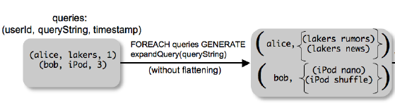
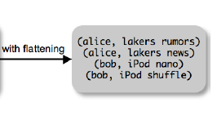

Slide 89
FLATTEN
Note that it is NOT a first class function !
(that’s one thing I don’t like about Pig-latin)
First class FLATTEN:
FLATTEN({{2,3},{5},{},{4,5,6}}) = {2,3,5,4,5,6}
Type: {{T}} → {T}
Pig-latin FLATTEN
FLATTEN({4,5,6}) = 4, 5, 6
Type: {T} → T, T, T, …, T ?????

Slide 90
FILTER
Remove all queries from Web bots:
real_queries = FILTER queries BY userId neq ‘bot’
Better: use a complex UDF to detect Web bots:
real_queries = FILTER queries BY NOT isBot(userId)

Slide 91
JOIN
results: {(queryString, url, position)}
revenue: {(queryString, adSlot, amount)}
join_result = JOIN results BY queryString revenue BY queryString
join_result : {(queryString, url, position, adSlot, amount)}

Slide 92
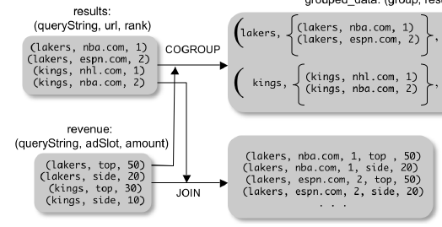

Slide 93
GROUP BY
revenue: {(queryString, adSlot, amount)}
grouped_revenue = GROUP revenue BY queryString
query_revenues =
FOREACH grouped_revenue
GENERATE queryString,
SUM(revenue.amount) AS totalRevenue
grouped_revenue: {(queryString, {(adSlot, amount)})}
query_revenues: {(queryString, totalRevenue)}

Slide 94
Simple Map-Reduce
input : {(field1, field2, field3, . . . .)}
map_result = FOREACH input
GENERATE FLATTEN(map(*))
key_groups = GROUP map_result BY $0
output = FOREACH key_groups GENERATE reduce($1)
map_result : {(a1, a2, a3, . . .)}
key_groups : {(a1, {(a2, a3, . . .)})}

Slide 95
Co-Group
results: {(queryString, url, position)}
revenue: {(queryString, adSlot, amount)}
grouped_data =
COGROUP results BY queryString,
revenue BY queryString;
grouped_data: {(queryString, results:{(url, position)}, revenue:{(adSlot, amount)})}
What is the output type in general ?

Slide 96
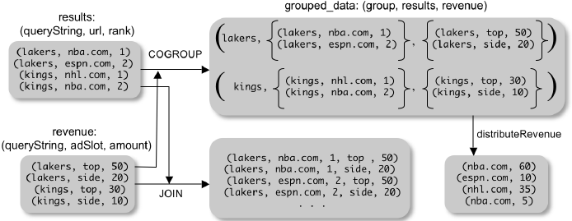
Co-Group
Is this an inner join, or an outer join ?

Slide 97
Co-Group
grouped_data: {(queryString, results:{(url, position)}, revenue:{(adSlot, amount)})}
url_revenues = FOREACH grouped_data
GENERATE
FLATTEN(distributeRevenue(results, revenue));
distributeRevenue is a UDF that accepts search re-
sults and revenue information for a query string at a time,
and outputs a bag of urls and the revenue attributed to them.

Slide 98
Co-Group v.s. Join
grouped_data: {(queryString, results:{(url, position)}, revenue:{(adSlot, amount)})}
grouped_data = COGROUP results BY queryString,
revenue BY queryString;
join_result = FOREACH grouped_data
GENERATE FLATTEN(results),
FLATTEN(revenue);
Result is the same as JOIN

Slide 99
Asking for Output: STORE
STORE query_revenues INTO `myoutput'
USING myStore();
Meaning: write query_revenues to the file ‘myoutput’

Slide 100
Implementation
Over Hadoop !
Parse query:
Everything between LOAD and STORE → one logical plan
Logical plan → sequence of Map/Reduce ops
All statements between two (CO)GROUPs → one Map/Reduce op

Slide 101
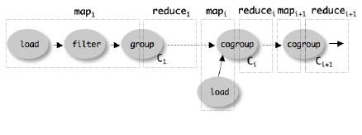
Implementation

Slide 102
Pig Latin Example Continued
Users(name, age)
Pages(user, url)
SELECT Pages.url, count(*) as cnt FROM Users, Pages WHERE Users.age in [18..25] and Users.name = Pages.user
GROUP BY Pages.url
ORDER DESC cnt

Slide 103
Example
Problem: many Pages, but only a few visited by users with age 18..25
Pig’s solution:
MAP phase sends all pages to the reducers
How can we reduce communication cost ?

